Slide 1
MPD: Moving Target Defense through Communication Protocol Dialects
Yongsheng Mei,
Kailash Gogineni,
Tian Lan,
Guru Venkataramani

Slide 2
The increasing scale of Internet of Things (IoT)
Diversified capabilities
Sensing, actuating, processing, and communication
Various integrated components
Software, application libraries, middleware, embedded systems, and network artifacts
Notes:
IoT integrates and relies on various enabling components. Any vulnerability in these components would lead to exploitations to create serious threats

Slide 3
Dynamic defense method is needed
IoT related vulnerabilities are common
Denial of services attack and reconnaissance attack^{[1]}
Moving target defense (MTD) will diversify the attack surfaces
MTD will randomly change the properties of target configuration
Constantly evolving defense will decrease the attack efficiency
Example: changing IP addresses and ports to realize random port and address hoping^{[2]}
[1] Meneghello, F., Calore, M., Zucchetto, D., Polese, M., Zanella, A.: IoT: Internet of threats? a survey of practical security vulnerabilities in real IoT devices. IEEE Internet of Things Journal 6(5), 8182{8201 (2019)
[2] Luo, Y.B., Wang, B.S., Wang, X.F., Hu, X.F., Cai, G.L., Sun, H.: RPAH: Random port and address hopping for thwarting internal and external adversaries. In: 2015 IEEE Trustcom/BigDataSE/ISPA. vol. 1, pp. 263{270. IEEE (2015)

Slide 4
MPD: Motivation
Regular MTD methods have limitations
The configurations of low-level attributes (IP addresses, port numbers, etc.) restrict the defense diversity
Security threats in IoT protocols
Many low-end IoT products do not have strong security mechanisms embedded
Customizing standard protocol can create more variations
Leveraging application-layer properties
Selecting customized protocol with MTD dynamically

Slide 5



MPD: Threat Models
Denial of service (DoS) attacks
Message Queuing Telemetry Transport (MQTT) is a lightweight, publish-subscribe network protocol that transports messages between devices.
Flood victim with CONNECT requests
Attacker
MQTT client
Legitimate request cannot get through
MQTT broker
Notes:
An attacker can launch a DoS attack by sending many CONNECT requests continuously thereby maliciously making the server busy as in requests flooding.
As the server is not able to differentiate the legitimate CONNECT and the malicious CONNECT packets, it starts to acknowledge all incoming packets with CONNACK. Assuming many connection requests that arrive at the same time, the buffer will be drained and the server will not be capable to process new incoming requests.

Slide 6
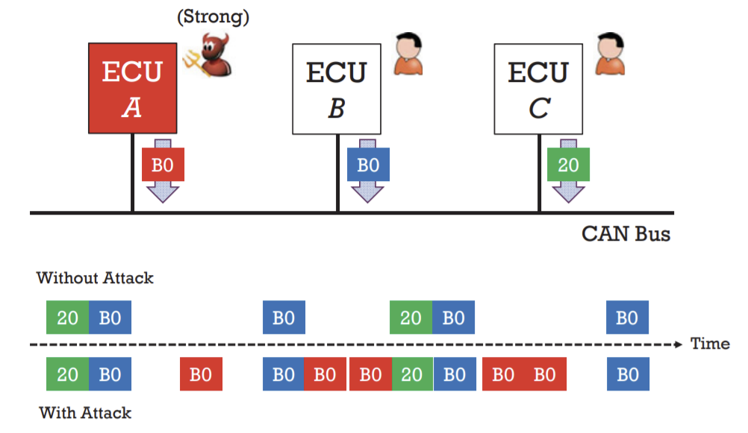
MPD: Threat Models
Inject command attack
Controller area network (CAN) protocol is message-based protocol designed to allow microcontrollers and devices to communicate with each other's applications.
Notes:
Due to no encryption or authentication in CAN protocol, attackers can use a reprogrammed electronic control unit (ECU) to send fake packet to the CAN bus.
The fake packets are fabricated and injected with forged ID and data to distract target ECUs or force them execute malformed action.

Slide 7
MPD: Problem Statement
MPD aims to customize a standard protocol and create moving target defense by:
Fabricating desired protocol dialects
Allowing servers & clients to dynamically select dialects in a synchronous way
Definition 1: Protocol Dialect
Given a standard communication protocol, a dialect is a variation created by mutating its packets and handshakes while keeping the communication functionalities unchanged.

Slide 8
MPD: System Design
Moving target customization (MTC)
Creating customized packets using dialect generating functions
Self-synchronizing mechanism (SSM)
Ensuring the server and the client remain synchronized with respect to their selected dialect
Protocol dialect management (PDM)
Selecting a protocol dialect for the packet

Slide 9
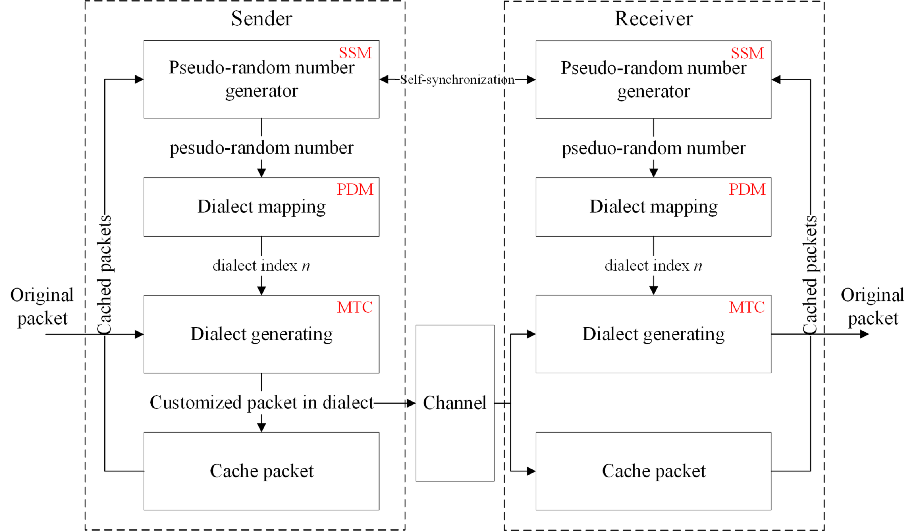
MPD: System Design

Slide 10
MPD: Moving Target Customization (MTC)
MTC module utilizes dialect generating functions to create protocol dialects
Functions can sufficiently mutate communication packets
Inverse function exists to recover original packets
Customized dialects
Shuffling: Generate various protocol dialects by switching randomly selected segments from original packet in application layer
Splitting: Generate dialects by splitting application-layer information of one packet into several sub-packets

Slide 11
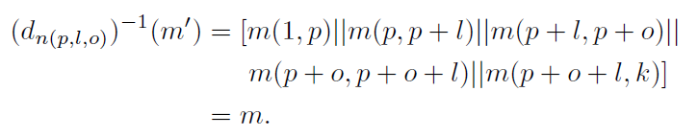
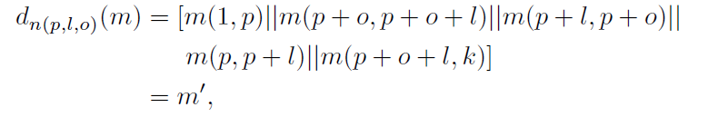
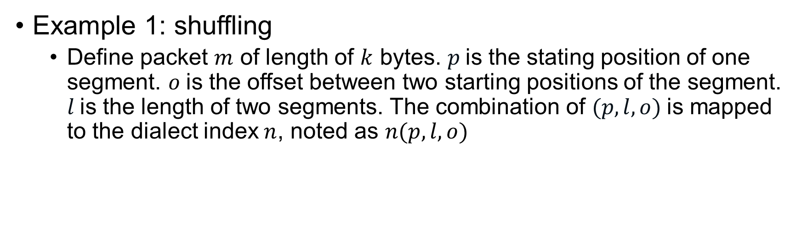

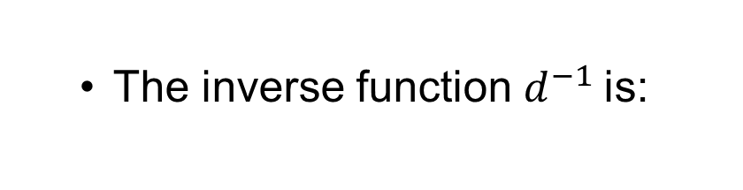
MPD: Moving Target Customization (MTC)
Example 1: shuffling
Define packet $m$ of length of $k$ bytes. $p$is the stating position of one segment. $o$is the offset between two starting positions of the segment. $l$is the length of two segments. The combination of $(p,l,o)$is mapped to the dialect index $n$, noted as $n(p,l,o)$
The inverse function $d^{−1}$is:
Dialect generating function $d$to create customized packet $m′$ is:

Slide 12
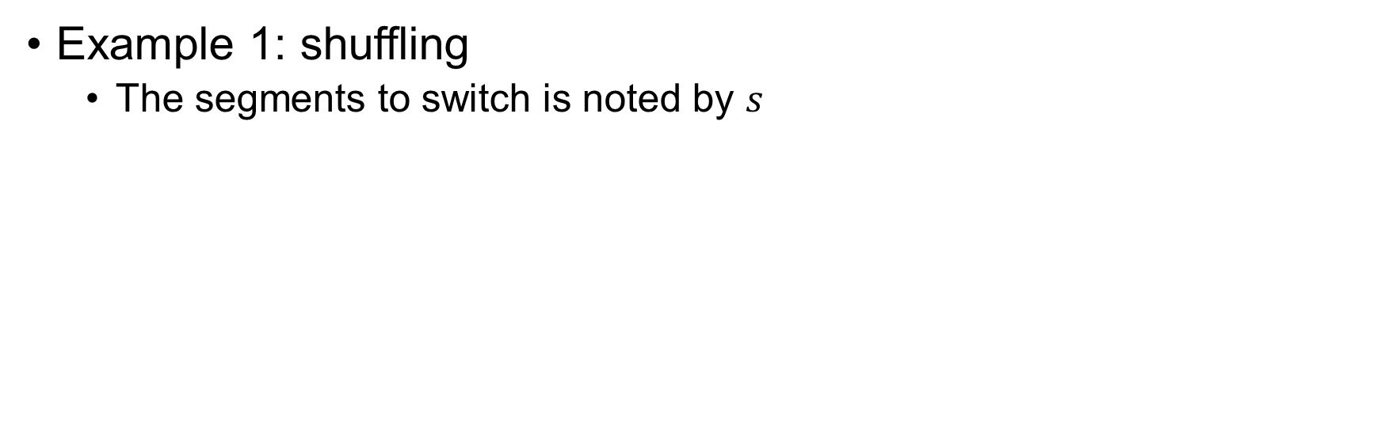
MPD: Moving Target Customization (MTC)
Example 1: shuffling
The segments to switch is noted by $s$

Slide 13
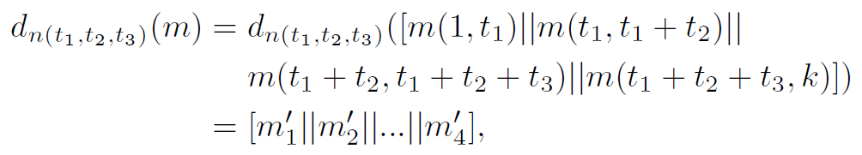
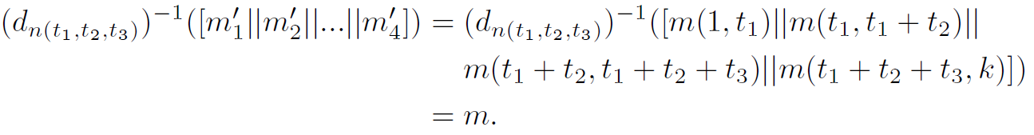
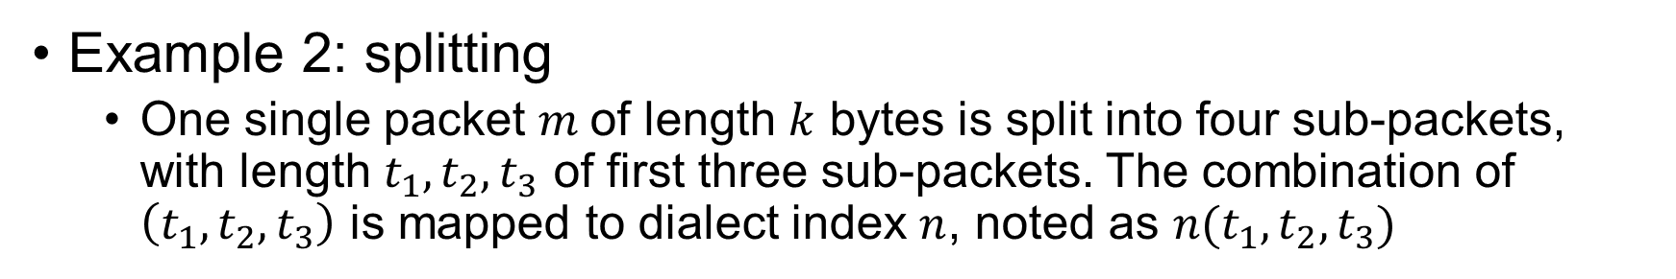
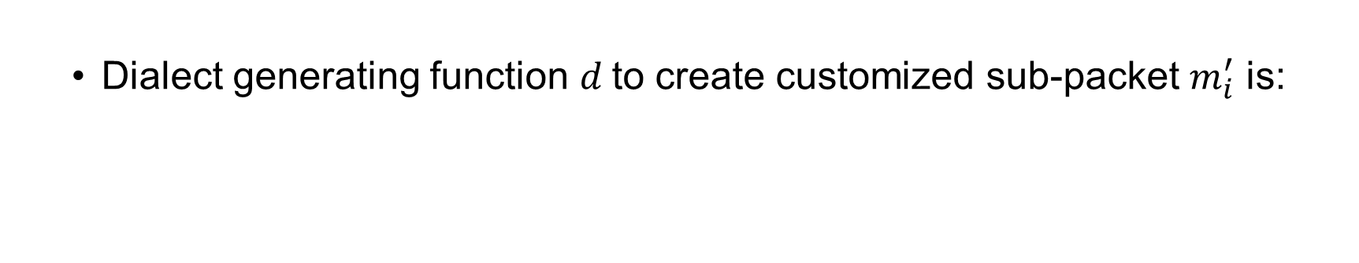
MPD: Moving Target Customization (MTC)
Example 2: splitting
One single packet $m$of length $k$ bytes is split into four sub-packets, with length $t_{1}, t_{2}, t_{3}$ of first three sub-packets. The combination of $\left(t_{1}, t_{2},t_{3}\right)$ is mapped to dialect index $n$, noted as $n(t_{1},t_{2},t_{3})$
The inverse function $d^{−1}$ is:
Dialect generating function $d$to create customized sub-packet $m_{i}^{′}$ is:

Slide 14
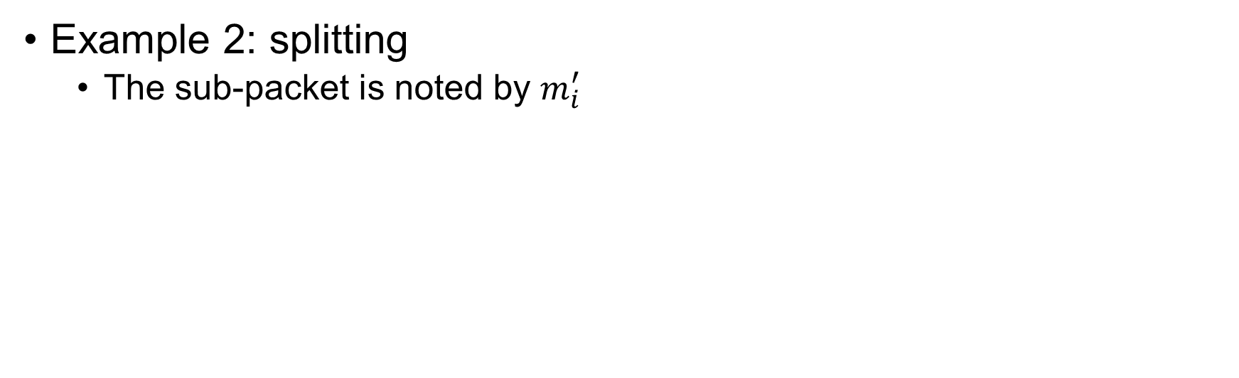
MPD: Moving Target Customization (MTC)
Example 2: splitting
The sub-packet is noted by $m_{i}^{′}$

Slide 15
MPD: Self-synchronization Mechanism (SSM)
SSM module ensures the unpredictability and synchronization of dialect selection
The client/server selects the dialect unpredictable to eves-droppers
The dialect on both sides remain synchronized during communication
SSM leverages a pseudo-random number generator (PRNG) to create randomness for selecting random dialect.

Slide 16
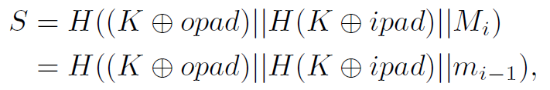
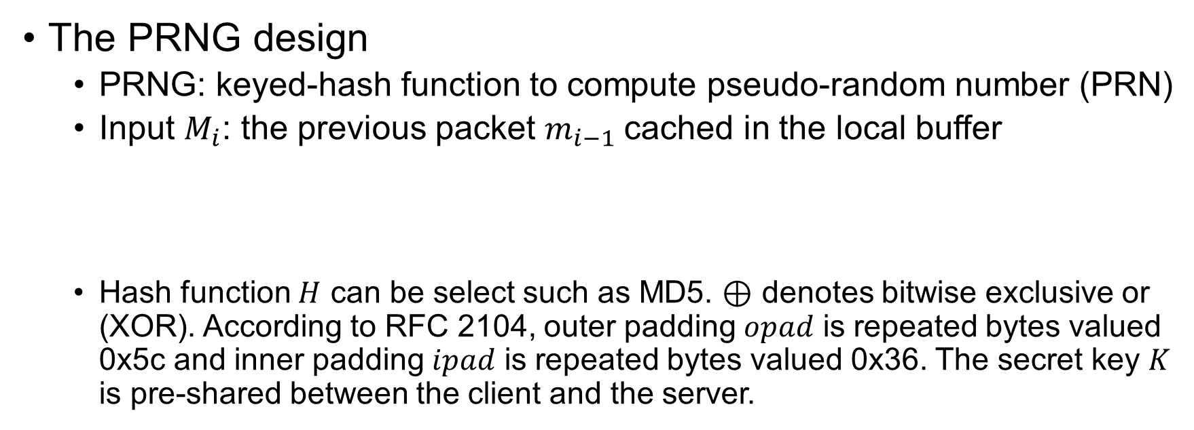
MPD: Self-synchronization Mechanism (SSM)
The PRNG design
PRNG: keyed-hash function to compute pseudo-random number (PRN)
Input $M_{i}$: the previous packet $m_{i−1}$cached in the local buffer
Hash function $H$ can be select such as MD5. ⊕ denotes bitwise exclusive or (XOR). According to RFC 2104, outer padding $opad$ is repeated bytes valued 0x5c and inner padding $ipad$ is repeated bytes valued 0x36. The secret key $K$ is pre-shared between the client and the server.

Slide 17
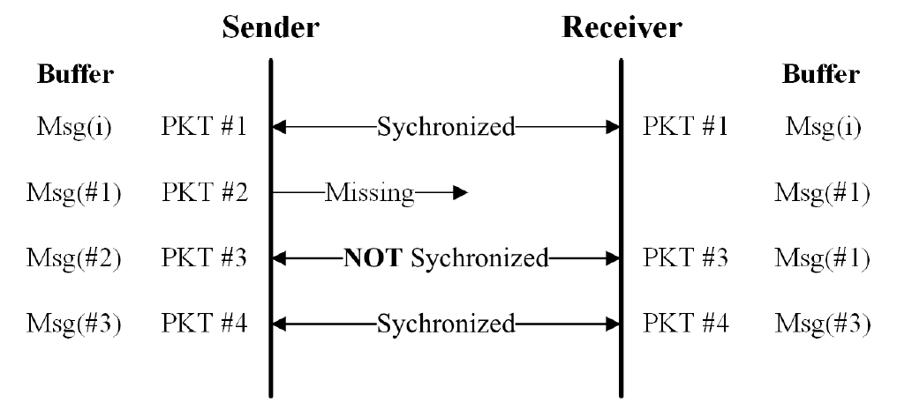
MPD: Self-synchronization Mechanism (SSM)
The Self-synchronization mechanism

Slide 18
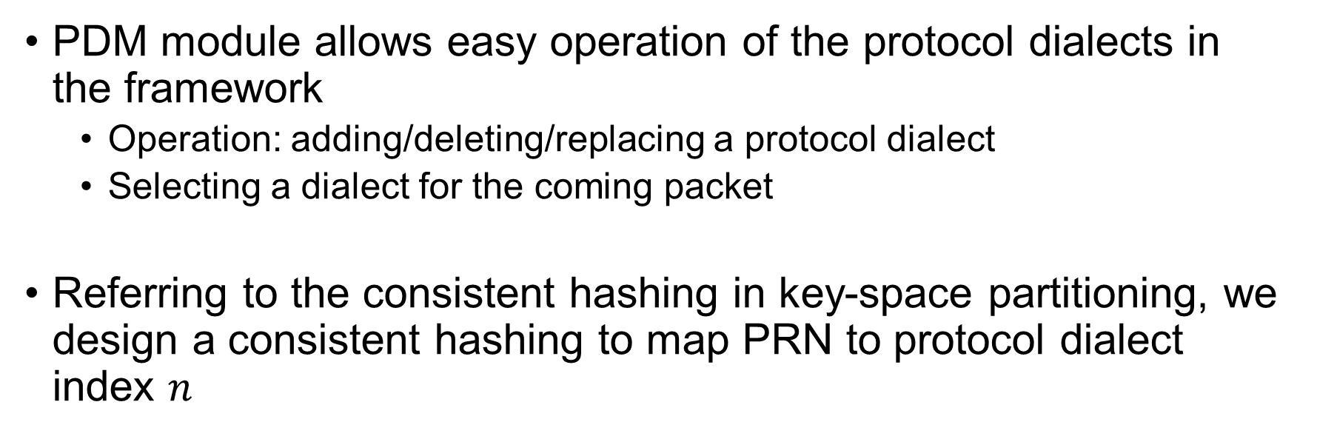
MPD: Protocol Dialect Management (PDM)
PDM module allows easy operation of the protocol dialects in the framework
Operation: adding/deleting/replacing a protocol dialect
Selecting a dialect for the coming packet
Referring to the consistent hashing in key-space partitioning, we design a consistent hashing to map PRN to protocol dialect index $n$

Slide 19
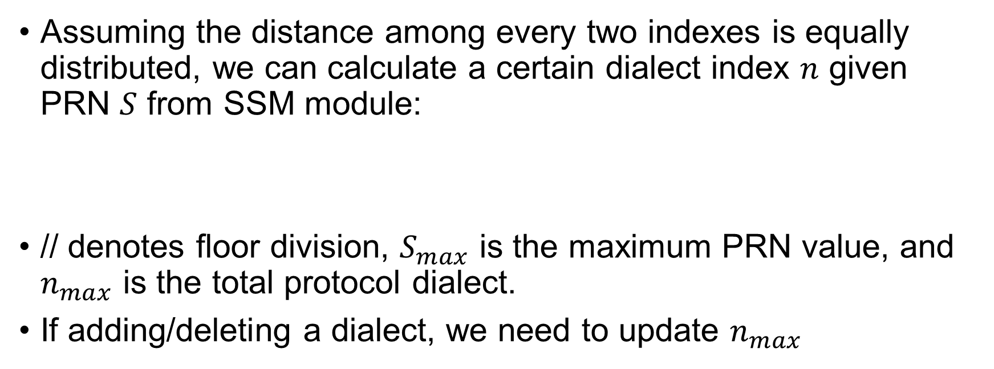
MPD: Protocol Dialect Management (PDM)
Assuming the distance among every two indexes is equally distributed, we can calculate a certain dialect index $n$ given PRN $S$ from SSM module:
// denotes floor division, $S_{max}$ is the maximum PRN value, and $n_{max}$ is the total protocol dialect.
If adding/deleting a dialect, we need to update $n_{max}$

Slide 20
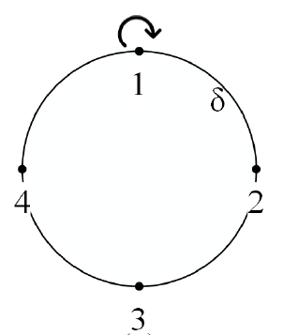
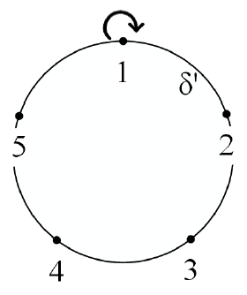
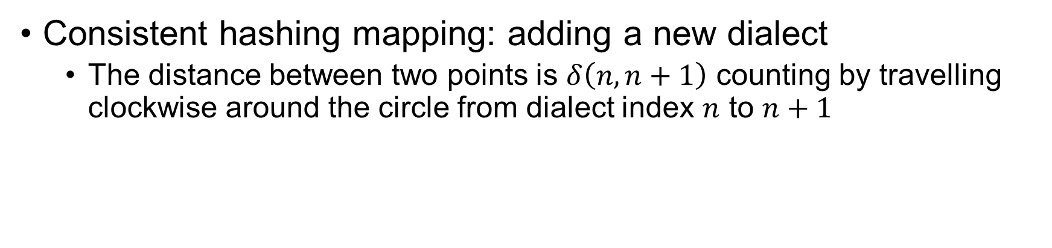
MPD: Protocol Dialect Management (PDM)
Consistent hashing mapping: adding a new dialect
The distance between two points is $δ\left(n,n+1\right)$ counting by travelling clockwise around the circle from dialect index $n$ to $n+1$

Slide 21
Evaluation
Setup
2.60GHz Intel(R) Core(TM) CPU i7-9750H 6-core
16 GB memory
OS: Ubuntu 18.04 LTS
Target protocol
File transfer protocol (FTP)
Message queuing telemetry transport (MQTT)

Slide 22
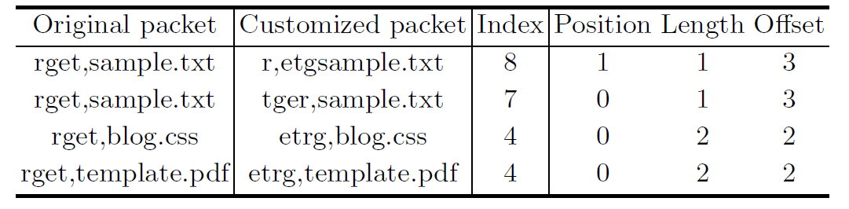
Evaluation
Customized protocol dialects: shuffling
Computing for different FTP GET command

Slide 23
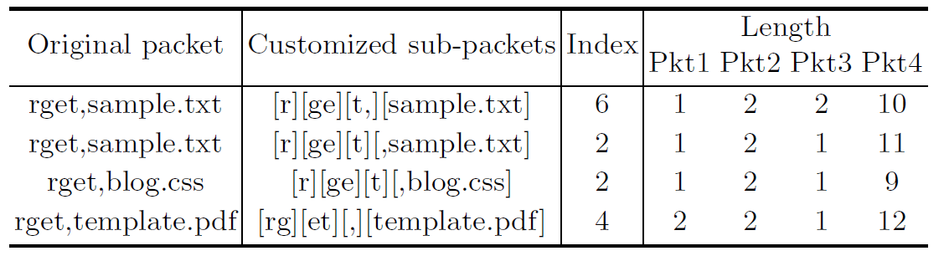
Evaluation
Customized protocol dialects: splitting
Computing for different FTP GET command

Slide 24
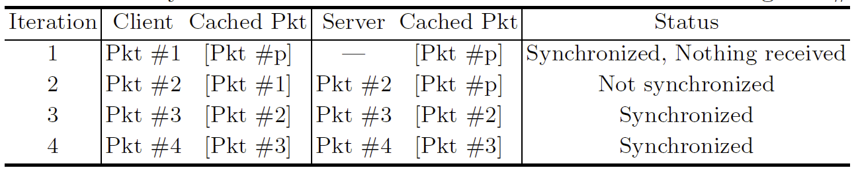
Evaluation
Defend packet erased/missing: self-synchronization
We set Pkt #1 is erased/missing
Pkt #p is the previously sent packet

Slide 25
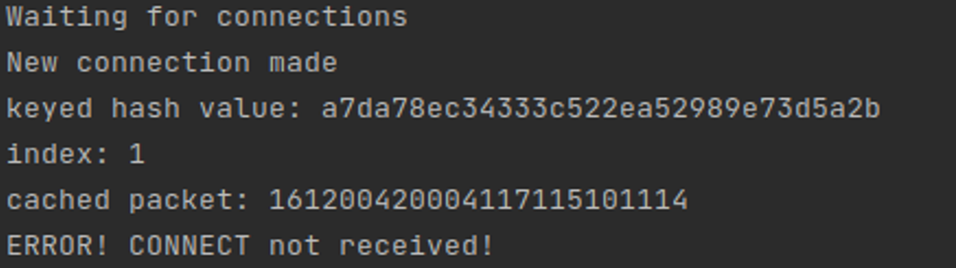
Evaluation
Defend DoS attack: MQTT
The attacker MQTT client flush the modified MQTT server to exhaust its buffer by continuously sending CONNECT packet
Attack failed: Cannot pass the dialect index check

Slide 26
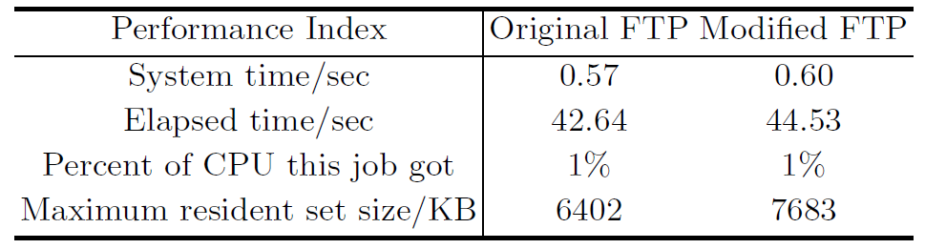
Evaluation
Overhead: Compare with standard FTP implementation
Test on the server-side
Run each experiment four times and record the average overhead
Execute one billion FTP GET commands to retrieve a small text file
Notes:
System time: time spent in kernel mode while running the program.
Maximum resident set size: Maximum memory space occupied while running the program.

Slide 27
Conclusion
We design and evaluate a novel moving target defense framework, MPD, which generates sufficient customized protocol dialects
MPD can dynamically select dialects in a self-synchronous manner
Experiment results using FTP and MQTT indicate that MPD can harden the security while incurring low execution overhead

Slide 28
Future Work
Integrating MDP into other protocols
Exploring different pseudo-random number generators

Slide 29
Thank you!

